Slide 1

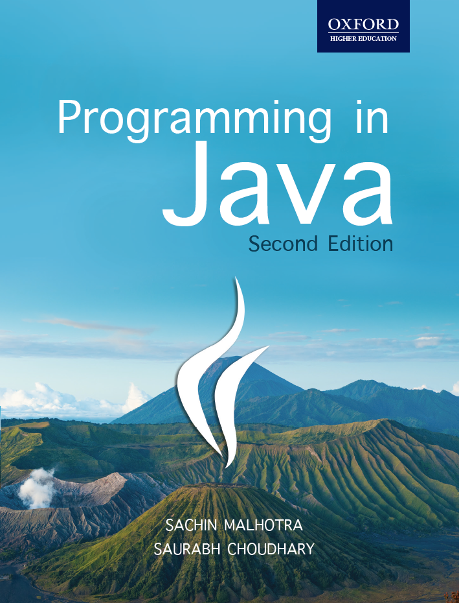
Programming in Java, 2e
Sachin Malhotra
Saurabh Choudhary

Slide 2
Chapter 3
Java Programming Constructs

Slide 3
Objective
Understand how Variables are used in Java
Understand the basic Data types
Learn Expressions and Conditional Statements
Understand all the available operation in Java
Understand the basic of Conversion and Casting
Understand Loops and Branching statements

Slide 4
Variables
a symbolic name
used to store value which can change during execution of the program.
int noOfWatts = 100; // variable declaration
declaration involves specifying the
  type (Data Type),
  name (Identifier) and
  value (Literal) according to the type of the variable.

Slide 5
Primitive Data Types
byte
short
int
long
float
double
boolean
char

Slide 6
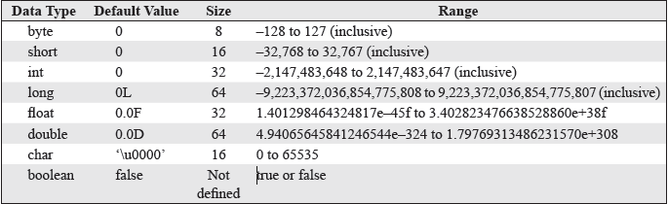
Data types default values and their range

Slide 7
Identifiers
Identifiers are names assigned to variables, constants, methods, classes, packages and interfaces.
No limit has been specified for the length of a variable name.

Slide 8
Rules for Naming
The first character of an identifier must be a letter, an underscore (_), or a dollar sign ($).
Use letter, underscore, dollar sign, or digit for subsequent characters. Note that white spaces are not allowed within identifiers.
Identifiers are case-sensitive. This means that Total_Price and total_price are different identifiers.
Do not use Java’s reserved Keywords.

Slide 9
Valid and invalid identifiers
Legal Identifiers
  MyClass
  $amount
  _totalPay
  total_Commission
  Illegal Identifiers
  My Class
  23amount
  -totalpay
  total@commission

Slide 10
Naming Conventions
Class or Interface identifiers begin with a capital letter. First alphabet of every internal word is capitalized. All other letters are in lowercase.
Variable or Method identifiers start with a lowercase letter. First alphabet of every Internal word is capitalized. All other letters are in lowercase.
Constant identifiers All letters are specified in Upper case. Underscore is used to separate internal words (_).
Package identifiers consist of all lowercase letters.

Slide 11
Literals
value which can be passed to a variable
Literals can be
  numeric (for byte, short, int, long, float, double),
  boolean,
  character,
  string or null literals.
Integer literals can be decimal, octal, hexadecimal or even binary
All integer literals are of type int, by default.
To define them as long, we can place a suffix of L or l after the number for instance:
  long l = 2345678998L;

Slide 12
Octal, Binary and Hexa Literals
  Octal literals, the value must be prefixed with zero and only digits 0 through 7 are allowed.
    int x = 011; //value in x is 9
  Hexadecimal literals are prefixed with 0x or oX; digits 0 through 9 and a through f (or A through F) are only allowed.
    int y = 0x0001; //value in y is 1
  Binary literals are a combination of 0’s and 1’s. Binary literals can be assigned to variables in Java 7. Binary literals must be prefixed with 0b or 0B (zerob or zeroB)
    char bin1 = 0b1010000; // value in bin1 will be P
    char bin2 = 0b1010001; // value in bin2 will be Q
    float bin3 = 0b1010000; // value in bin3 will be 80.0
    int bin4 = 0b1010001; // value in bin4 will be 81

Slide 13
Underscores with literals
Java 7 onwards the readability of literals can be enhanced by using underscore with numeric literals.
As the number of zeroes increase in a literal, counting the number of zeroes becomes tedious.
  int numlit=100_000_000; // value in numlit will be 100000000

Slide 14
Underscores with literals
Underscores can be used with decimal literals, hexa, binary, and octal literals
  int numlit=0x100_000; // value in numlit1 will be 1048576
  int bin=0B1_000_000_000_000_001; // vale in bin will be 32769
  float octlit=03_000; // value in octlit will be 1536.0
float e = 4_.2_3f; // illegal use of underscore with a dot

Slide 15
Valid and Invalid use of underscores within literals
Note Underscore can only be used with literal values.
The following examples show some valid and invalid use of underscores.
  int i =_23; // illegal, cannot start a literal with underscore
  long f = 3_2_222_2_l; // invalid use of underscore between value and suffix
  long f = 3_2_222_2l; // legal

Slide 16
Literals
String literals consists of zero or more characters within double quotes.
  String s = “This is a String Literal”;
Null literal is assigned to object reference variables.
  s =null;
All floating literals are of type double, by default.
For float literals, suffix F or f.
for double literals, D or d are suffixed to the end (optional)
  float f = 23.6F;
  double d = 23.6;
For char literals, a single character is enclosed in single quotes.
  char sample = ‘A’
  the prefix \u followed by four hexadecimal digits represents 16-bit Unicode character:
  char c = ‘\u004E’

Slide 17
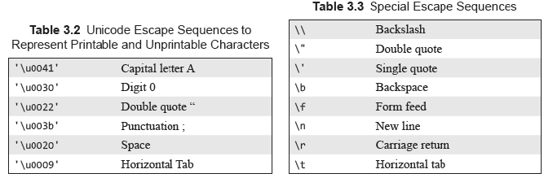
Escape Sequence

Slide 18
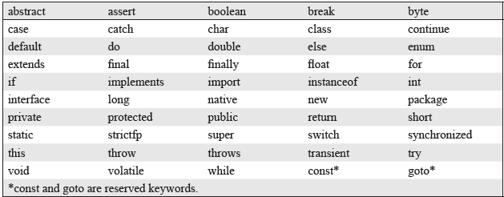
Keywords

Slide 19
Operators
Assignment Operators (=)
Arithmetic Operator (+, -, *, /, %)
Relational Operators (==, <,>,<=,>=, !=)
Boolean Logical Operators
  Can be applied to Boolean operands (or expressions) and return a boolean value.
  conditional OR (||) and conditional AND (&&)
  logical OR (|),
  logical AND (&),
  logical XOR (^)
  unary logical NOT (!)

Slide 20
Boolean logical Operators
boolean a=true,b=false;
System.out.println(“Logical OR: “+ a +” | “+b+”: “+(a|b));
System.out.println(“Logical XOR: “+ a +” ^ “+b+”: “+(a^b));
System.out.println(“Logical AND: “+ a +” & “+b+”: “+(a&b));
System.out.println(“Logical NOT: !a : “+(!a));
System.out.println(“Conditional OR: “+ a +” || “+b+”: “+(a||b));
Syste m.out.println(“Conditional AND: “+ a +” && “+b+”: “+(a&&b));
// shortcut operator
a |= b;
System.out.println(“shortcut OR: “+ a +” | “+b+” = “+(a));

Slide 21
The Output
Logical OR: true | false: true
Logical XOR: true ^ false: true
Logical AND: true & false: false
Logical NOT: !a : false
Conditional OR: true || false: true
Conditional AND: true && false: false

Slide 22
Bitwise operators
include and, or, xor, not, right shift, left shift and unsigned right shift.
Operate on int and long values. If any of the operand is shorter than an int, it is automatically promoted to int before the operations are performed

Slide 23
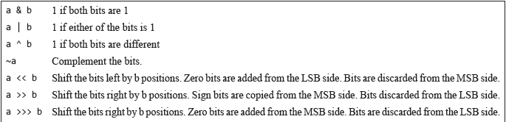
Bitwise operators

Slide 24
Bitwise Operators
class BitwiseOperatorDemo {
public static void main(String args[]) {
int x=2,y=3;
System.out.println(“Bitwise AND: “+x+”&”+y+”=”+(x&y));
System.out.println(“Bitwise OR : “+x+”|”+y+”=”+(x|y));
System.out.println(“Bitwise XOR: “+x+”^”+y+”=”+(x^y));
System.out.println(“Bitwise NOT: ~”+x+”=”+(~x));
}}

Slide 25
The Output
Bitwise AND: 2&3=2
Bitwise OR : 2|3=3
Bitwise XOR: 2^3=1
Bitwise NOT: ~2=-3

Slide 26
Compound Assignment Operators
+=
-=
*=
/=
%=
&=
|=
^=
<<=
>>=
>>>=
Note: The compound Assignment Operator includes an implicit cast

Slide 27
Shift Operator
Left shift
  operator shift the numbers of bits specified, towards left.
  Bits are discarded from the left and added form the right with the value of bits being zero.
Right shift
  operator shift the numbers of bits specified, towards right.
  Bits are discarded from the right and added form the left side with the value of bits being that of the sign bit.
Unsigned right shift,
  shifts the numbers of bits specified, towards right.
  Bits are discarded from the right and added form the left side with the value of bits being zero.

Slide 28
Shift Operators
Assume x=4 and this x is to be shifted by the shift distance of 1.
int y = x>>1;
  y has the value 2, value is halved in each successive right shift
  00000000 00000000 00000000 00000100>>1
  00000000 00000000 00000000 00000010 (which is 2).
  int y = x<<1;
  y has the value 8, value is doubled in each successive left shift
int y = x>>>1;
  same as right shift for +ive numbers.

Slide 29
Increment and Decrement
Increment and Decrement Operators
  can be applied to all integers and floating-point types.
  can be either in prefix (--x, ++x) or postfix (x--, x++) mode.
Prefix Increment/Decrement Operation
  int x = 2;
  int y = ++x; // x = 3, y = 3
  int z= --x; // x = 1, z = 1
Postfix Increment/Decrement Operation
  int x = 2;
  int y = x++; // x == 3, y == 2
  int z = x--; // x = 1, z = 2

Slide 30
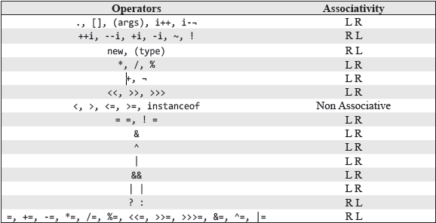
Precedence and Associativity

Slide 31
Your Turn
What is the role of precedence and associativity?
How are hexadecimal integers literals defined in java?
How are Binary literals defined in java?
What are shift operators?
Why and how underscores are defined in literals?

Slide 32

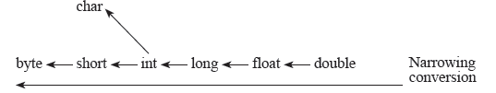
Conversion and Casting
Conversions are performed automatically
  For e.g. a smaller box can be placed in a bigger box and so on.
Casting also known as narrowing conversion (reverse of widening conversion).
  A bigger box has to be placed in a small box.
  Casting is not implicit in nature.
  Use casting operator i.e. ()
  int i = (int)(8.0/3.0);

Slide 33
Conversion and Casting
class CastingAndConversionExample
{ public static void main(String args[])
{
  int i=(int)(8.0/3.0);
  int j=(int)2147483648.0f;
  System.out.println(“i = “+i+” j= “+j);
  byte b=(byte)257;
  short s=(short)65537;
  System.out.println(“b= “+b+” s= “+s);
  System.out.println(“ Converting int to char “ +(char)75);
  double d = i * b * s * 2.0;
  System.out.println(“Conversion to double result is : “+d);
  i=b<<2;
  System.out.println(“i = “+i);
  }}

Slide 34
The output
i = 2 j= 2147483647
b= 1 s= 1
Converting int to char K
Conversion to double result is : 4.0
i = 4

Slide 35
Flow of Control
Conditional Statements
Loops
Branching statements
Exceptions (chap 9)

Slide 36
Conditional Statement
if…else
The syntax of if statement is as follows:
if (x = = 0)
{// Lines of code}
else if(x = =1)
{// Lines of code}
………
else
{// Lines of code}

Slide 37
Switch case
switch (x) {
case 0:
// Lines of code
doSomething0();
break;
case 1:
// Lines of code
doSomething1();
break;
.
.
case n:
// Lines of code
doSomethingN();
break;
default:
doSomethingElse();
}

Slide 38
switch..case
x must be one of these: int, byte, short, char, enum, String (Java 7 onwards) or one of the wrapper class (namely: Byte for byte, Short for short, Character for char, Integer for int.).
Can also be an expression that returns an int, byte, short or char.

Slide 39
for Loop
class ForDemo
{
public static void main(String args[])
{
for(int i=1;i<=5;i++)
System.out.println(“Square of “+i+” is “+ (i*i));
} }

Slide 40
The Output
The output is as follows:
Square of 1 is 1
Square of 2 is 4
Square of 3 is 9
Square of 4 is 16
Square of 5 is 25

Slide 41
while Loop
class WhileDemo
{
public static void main(String args[])
{
int i=1;
while(i<=5)
{
System.out.println(“Square of “+i+” is “+ (i*i));
i++;
} }
}

Slide 42
The Output
The output is as follows:
Square of 1 is 1
Square of 2 is 4
Square of 3 is 9
Square of 4 is 16
Square of 5 is 25

Slide 43
do…while loop
class DoWhileDemo
{
public static void main(String args[])
{ int i=1;
do
{
System.out.println(“Square of “+i+” is “+ (i*i));
i++;
}while(i<=5);
}}

Slide 44
The Output
The output is as follows:
Square of 1 is 1
Square of 2 is 4
Square of 3 is 9
Square of 4 is 16
Square of 5 is 25

Slide 45
for..each
for (type var : arr) {
// Statements to repeat
}
to access each value successively in a collection of values (like array).
Like for loops, these loops perform a fixed number of iterations.
But Unlike them, for- each loop determine its number of steps from the size of the collection.

Slide 46
break
class PrimeDemo{
public static void main(String[] args){
int j,k;
System.out.print(“Prime numbers between 1 to 30 : “);
for (j = 1; j < 30; j++ ){
for (k = 2; k < j; k++ ){
if(j % k == 0) break;
}
if(j == k)
{
System.out.print(j+” “);
}
}}}

Slide 47
The Output
Prime numbers between 1 to 30 : 2 3 5 7 11 13 17 19 23 29

Slide 48
Labeled break
class LabeledBreakDemo{
public static void main(String args[])
{
Outer : for(int i=0; i < 4 ; i++){
for(int j = 1; j < 4; j++) {
System.out.println(“i:” + i + “ j:” + j);
if(i == 2) break Outer;
}}}}

Slide 49
The output
i:0 j:1
i:0 j:2
i:0 j:3
i:1 j:1
i:1 j:2
i:1 j:3
i:2 j:1

Slide 50
continue
while ( i < 5){
//doSomething1;
if(i<4) continue;
//doSomething2;
}

Slide 51
Labeled continue
jmp0: while (i < 5){
for (int i=0; i<4; i++){
if( i==2) continue jmp0;
//dosomething;
}
}

Slide 52
Summary
Variables holds data at memory locations allocated to them.
There are eight basic data types in java, namely, byte, short, int, long, float, double, boolean and char.
Java does not leave the size of data types to the machine and the compiler.
All integer (byte, short, int, long) and floating-point types (float, double) are signed in java.
operators can be classified as arithmetic, relational, logical, assignment, increment and decrement, conditional, bit-wise, and shift operator.

Slide 53
SUMMARY (contd.)
Expressions are formed with variables and operators.
Operators in java have certain precedence and associativity rules that are followed while evaluating expressions.
Automatic type conversion takes place according to set rules in expressions with mixed types.
Explicit type conversion (a.k.a Casting) is also possible in java.

